Slide 1
Innovative School in Bulgaria - perspectives and problems to solve
INNOVATION: DRIVING FORCES AND GOALS: INNOVATION VERSUS CHANGE
Sofia, Bulgaria, 27 – 29 March 2019

Slide 2
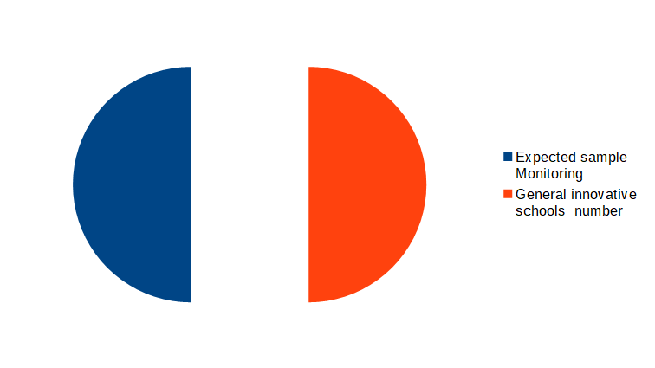
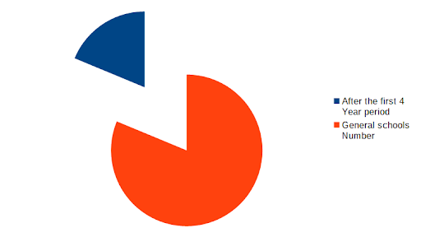
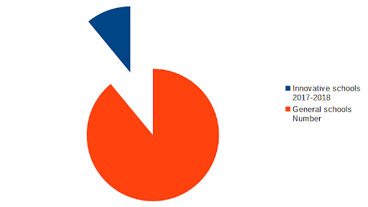
Some facts upfront
We currently have out 294 schools with innovative status from 2383
We can expect about 500-550 innovative schools
We have 100% monitoring
Notes:
1. Since 31st January, 2017, we have conducted three application procedures for innovative school status. Two of them have been completed successfully. The third wave of candidates is still awaiting evaluation. So we currently have out 294 schools with innovative status from 2383 in general in the education system.
2. We can predict that, if we keep up the trend of the first 4 year period, which is the maximum duration of an innovative project, we can expect about 500-550 innovative schools to operate in the system. This is likely to happen, but whether we will be able to keep up the trend, so that about 20-25% of schools have current innovative status, will depend on other things that I’ll discuss in the next minutes.
3. Currently, we have already conducted one monitoring that has covered all first wave schools - less than 200 schools with innovative status since the 2017/2018 school year. We are about to launch the second monitoring operation, which will encompass also those who have been approved and started their innovative projects in the recent 2018/2019 school year, meaning all 294 schools currently. (Here I due as a note that, the procedure is labor-intensive and cumbersome, and requires the physical presence of more than one member of the Commission - an external expert like me, a representative of the Ministry of Education and Science and of the local РУ, which makes it a budgetary burden.It is not tailored from one hand to the prospective growing number of innovative schools and from the other the available human resources of the Commission. Various other approaches to organizing the monitoring procedure may be considered – with help of modern ICTs it is easier to provide visualization of the activity, interviews with the target groups, and combine those with on-site monitoring by quota or other principle, or consider outsourcing…)

Slide 3



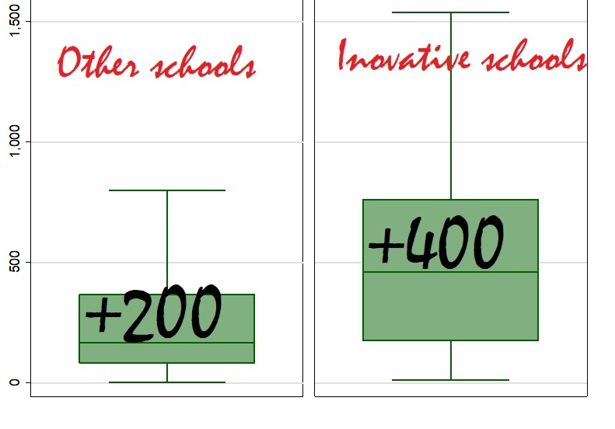
Conclusions: school LEVEL
Usually, it has a higher number of students than the country average, and this means a larger budget;
We find more often the presence of active parental advisory boards;
It does not suffer from a shortage of English and Informatics teachers;
In external evaluations, the score of the students from innovative schools are higher;
Notes:
Here are some important conclusions from the first monitoring session about what constitutes an innovative school
2. 70% from the innovative schools have officially registered board against 50% from the others.
3. The innovative schools have average 3 teachers in this subject and for the other schools they have difficulties to find even 1.
4. and this observation is valid and for Mathematics, for bulgarian language, and for all other.

Slide 4

Conclusions: school LEVEL
Innovative schools have students with higher socioeconomic status;
In general, innovative schools are concentrated in richer municipalities and wealthier areas.
64% profiled high schools against 9% from vocational schools
Notes:
5. even in smaller municipalities they are concentrated around the district center.
6. The main profile of the innovative high school covers the so-called elite high schools with linguistic, mathematical and natural science profiles from the past. It is important to note that during the first year of the program there was relatively low activity among vocational schools, where it appears much easier to unfold the potential of innovative schools. This is mainly the result of reminiscences from the past, when vocational education was labeled as unprestigious, unlike this one of mathematics, natural sciences, languages or humanities.

Slide 5
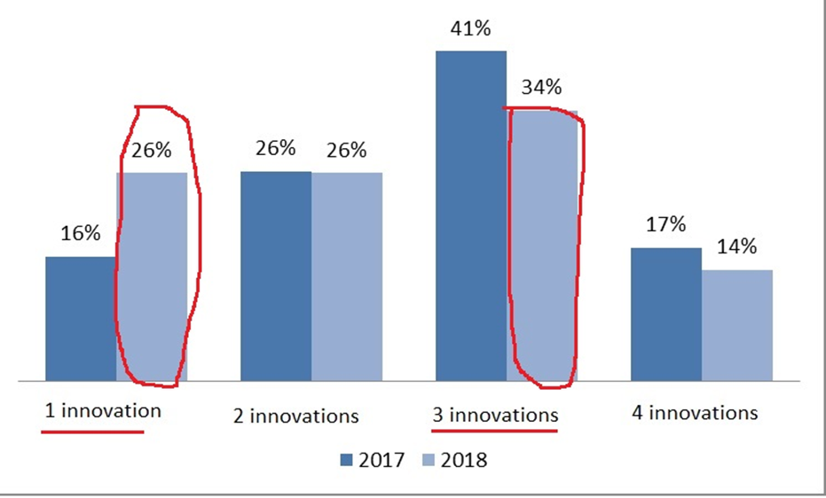
Conclusions: INNOVATION LEVEL
The four areas of innovation:
to develop and introduce innovative elements regarding the organization and / or the content of the educational process;
to organize in a new or improved way the school management, training and learning environment;
to use new teaching methods;
to develop new curricula.
Notes:
the most popular is combination between the first three options - app. 40%
the most unpopular is the fourth one – app 15% because she includes the most difficult – new subject
for me it is a good trend that in the second year the innovations are more focused even on 1 element.

Slide 6
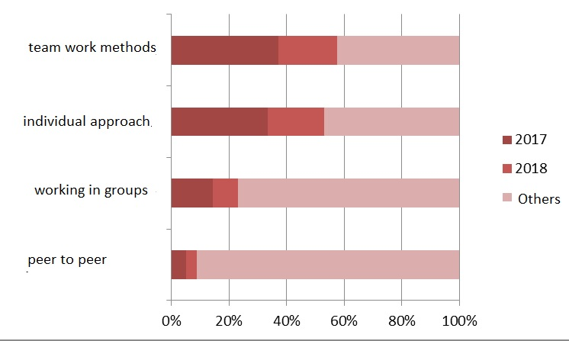
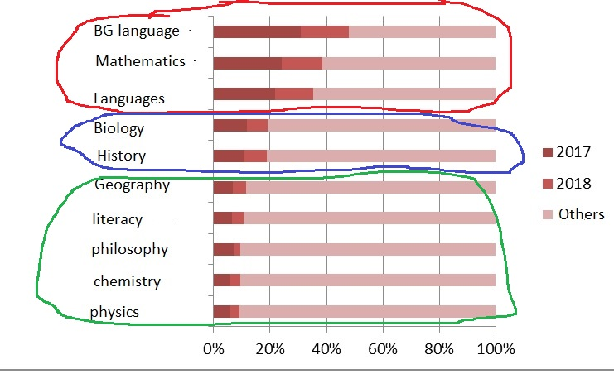
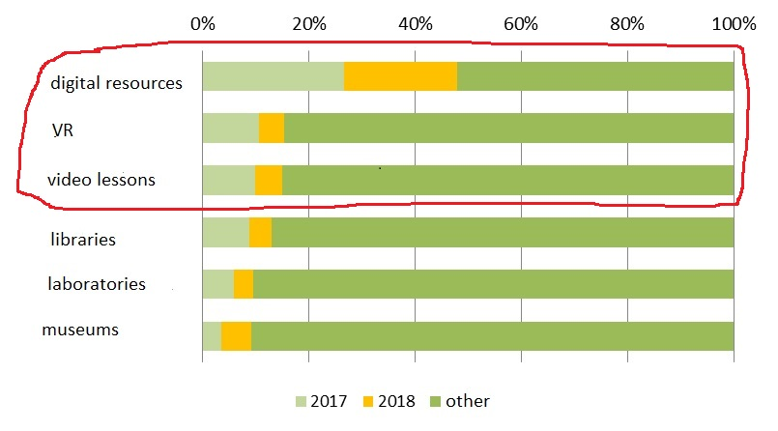
Conclusions: INNOVATION LEVEL
In which subjects are innovation focused?
The domination of ICT
Teaching methods
Notes:
1. we can notice some groups of interest - the first one is….on the second place...and the last....
2. In the field of the technical resources used to achieve innovation, we see a complete domination of ICT
3. The methodological approach is dominated by the teamwork methods, BUT with very strong presence of individual pedagogical work.

Slide 7

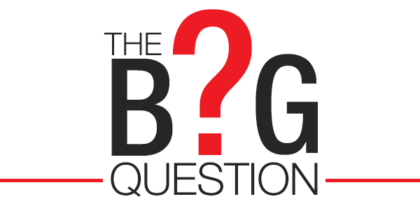
GENERAL QUESTIONS
Will we all become innovative at last?
The big question: when does innovation become the norm?
Notes:
1. It is important to note that the definition of what an innovative school is given in the new National Education Act and conditions to obtain this statute are outlined in a state educational standard. This makes it difficult to modify and if we have to extrapolate the trend from the current growth rates, then in 12 to 15 years we should expect that all schools have cycled through the status of innovative school for a period of 4 years. Or, we might expect a sharp decrease in interest among non-accredited schools, but this raises the question - who will fill the ranks of innovative schools?
2. if a school that has passed through a successful 4-year mandate, in order to continue to be innovative, it should submit a new project. But what about the old one, which we assume was successful?
And the important second question: Does a particular innovation become the norm only for the school that introduced it or can the state introduce it as the norm for other schools as well?

Slide 8

The temptation of an innovative school
Notes:
At this stage, the status of innovative school acts more like bait. it is a PR temptation, and sometimes a survival strategy. Status is a privilege, and in that sense it will be desired ... like a badge or label.

Slide 9
When will the innovative school program become sustainable?
When status is assigned to activity, not to desire and intent;
Clarification of the concept of innovation;
Changing the attitude towards the work of teachers-innovators in innovative schools.
Notes:
1. When status is assigned to activity, not to desire and intent. Now the program is generous to the candidates and there are no clear criteria.
2. This marks the other direction for development - clarification of the concept of innovation, categorization of innovation - according to its scale and importance – whether it is of national or local importance, according to its scalability, as well as according to the type of innovation.
3. And last but not least, when the work of teachers-innovators in innovative schools receives the qualitatively different appraisal it deserves....maybe they can by compensate бъ reducing school workload , maybe with higher honorarium...

Slide 10

the First step was already done!

